Slide 1

Decoding Consumer Behavior: A Data-Driven Marketing Strategy
By Abigail Sandquist, Connor O’Grady, and Michael Daley

Slide 2
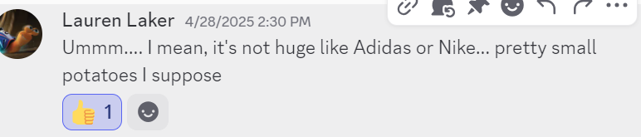
Setting the scene
eCommerce Retailer
Small-Midsize
Limited Marketing Budget

Slide 3

Objective
Create an accurate model with minimum financial risk and maximum efficiency of predicting customers’ purchasing habits.

Slide 4
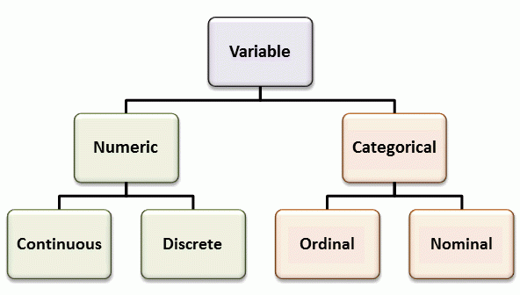
Important variables
Frequency
Web order
Time Spent on Website
Advertisement Source
Bing (Source_h)
Facebook (Source_a)

Slide 5
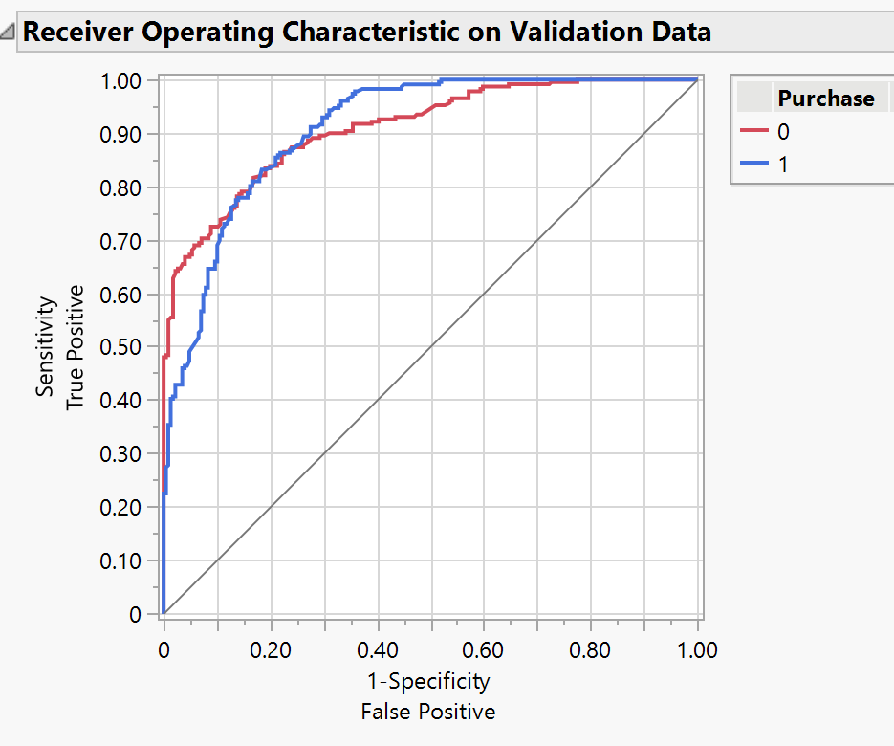
Model Results
Final Model: Bootstrap Forest – handles many variables and generalizes well
Validation Accuracy: 75.38%
Validation AUC: 0.9097 – strong ability to rank likelihood of purchase
Misclassification Rate: 19.12% – consistent with training performance

Slide 6
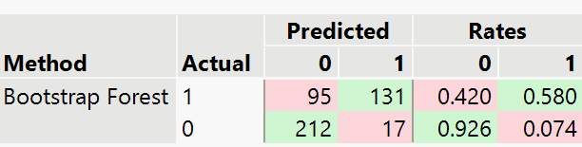
Model results pt. 2
Decision Threshold: 0.6626
High Specificity (92.58%) – helps avoid false positives and reduce wasted marketing spend
Supports marketing efficiency – targets likely buyers, minimizes outreach to non-buyers
Trade-off: May miss some potential buyers due to conservative targeting
Validation Confusion Matrix

Slide 7
Purchase Behavior & Marketing Stats
Targets
Facebook (a) – 160/202 = 79.21%
Industry Blog Post (p) – 10/11 = 90.91%
Pinterest (u) - 128/186 = 68.82%
Podcast ad (t) - 27/36 = 75%
Avoid
Bing ad (h) - 6/79 = 7.59%
Reddit (o) - 8/54 = 14.81%
All other variables tend to be tossup/unfavorable
33% - 56.34%

Slide 8

Future implications
Financial situation
Threshold adjustments
New campaigns

Slide 9

Conclusion
An effective but safe model
Grows the potatoes
Flexible future

Slide 10

Thank You

